Slide 1
Lecture. No 13
ARITHMETIC SERIES:
The sum of the terms of an arithmetic sequence forms an arithmetic series (A.S). For
example
1 + 3 + 5 + 7 + …
is an arithmetic series of positive odd integers.
In general, if a is the first term and d the common difference of an arithmetic series, then
the series is given as: a + (a+d) + (a+2d) +…

Slide 2
SUM OF n TERMS OF AN ARITHMETIC SERIES:
Let a be the first term and d be the common difference of an arithmetic series. Then its nth term is:
an = a + (n - 1)d; n ≥ 1 If Sn denotes the sum of first n terms of the A.S, then
Sn = a + (a + d) + (a + 2d) + … + [a + (n-1) d]
= a + (a+d) + (a + 2d) + … + an
= a + (a+d) + (a + 2d) + … + (an - d) + an ………(1) where an = a + (n - 1) d
Rewriting the terms in the series in reverse order,
Sn = an + (an - d) + (an - 2d) + … + (a + d) + a ……….(2) Adding (1) and (2) term by term, gives
2 Sn = (a + an) + (a + an) + (a + an) + … + (a + an) (n terms)
2 Sn = n (a + an)
⇒ Sn = n(a + an)/2
Sn = n(a + l)/2…………………..(3) Where l = an = a + (n - 1)d
Therefore
Sn= n/2 [a + a + (n - 1) d]
Sn= n/2 [2 a + (n - 1) d]……….(4)

Slide 3
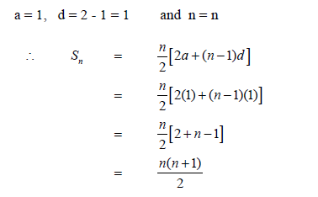
EXERCISE:
Find the sum of first n natural numbers.
SOLUTION:
Let Sn = 1 + 2 + 3 + … + n
Clearly the right hand side forms an arithmetic series with
a = 1, d = 2 - 1 = 1 and n = n

Slide 4

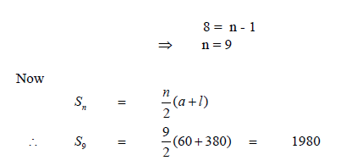
EXERCISE:
Find the sum of all two digit positive integers which are neither divisible by 5 nor by 2.
SOLUTION:
The series to be summed is:
11 + 13 + 17 + 19 + 21 + 23 + 27 + 29 + … + 91 + 93 + 97 + 99
which is not an arithmetic series.
If we make group of four terms we get
(11 + 13 + 17 + 19) + (21 + 23 + 27 + 29) + (31 + 33 + 37 + 39) + … + (91 + 93 + 97 +
99) = 60 + 100 + 140 + … + 380
which now forms an arithmetic series in which
a = 60; d = 100 - 60 = 40 and l = an = 380
To find n, we use the formula
an = a + (n - 1) d
⇒ 380 = 60 + (n - 1) (40)
⇒ 380 - 60 = (n - 1) (40)
⇒ 320 = (n - 1) (40)

Slide 5
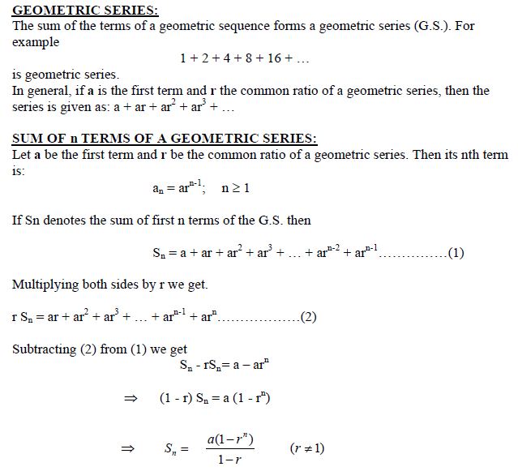

Slide 6
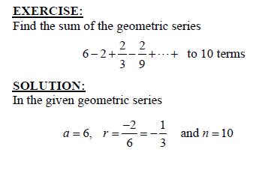
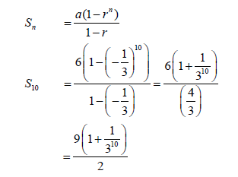

Slide 7
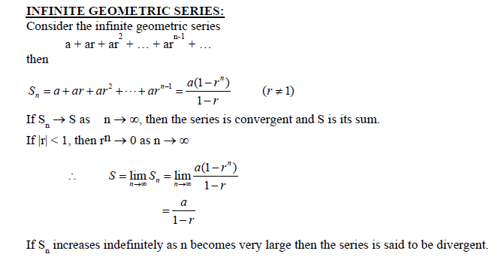

Slide 8
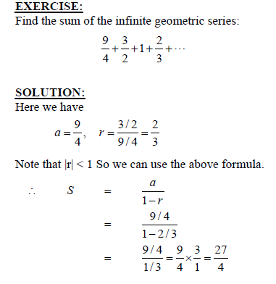

Slide 9
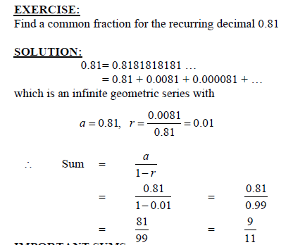

Slide 10
Recursion I
Recursion
First of all, instead of giving the definition of Recursion, we give you an example. You
already know the Set of Odd numbers. Here we give the new definition of the same set
that is the set of Odd numbers.
Definition for odd positive integers may be given as:
BASE:
1 is an odd positive integer.
RECURSION:
If k is an odd positive integer, then k + 2 is an odd positive integer.
Now, 1 is an odd positive integer by the definition base.
With k = 1, 1 + 2 = 3, so 3 is an odd positive integer.
With k = 3, 3 + 2 = 5, so 5 is an odd positive integer
and so, 7, 9, 11, … are odd positive integers.
REMARK: Recursive definitions can be used in a “generative” manner.

Slide 11
RECURSION:
The process of defining an object in terms of smaller versions of itself is called recursion.
A recursive definition has two parts:
1.BASE:
An initial simple definition which cannot be expressed in terms of smaller versions of itself.
2. RECURSION:
The part of definition which can be expressed in terms of smaller versions of itself.
RECURSIVELY DEFINED FUNCTIONS:
A function is said to be recursively defined if the function refers to itself such that
1. There are certain arguments, called base values, for which the function does not
refer to itself.
2. Each time the function does refer to itself, the argument of the function must be
closer to a base value.

Slide 12
EXAMPLE:
Suppose that f is defined recursively by
f(0) = 3, f(n + 1) = 2 f (n) + 3
Find f(1), f(2), f(3) and f(4)
SOLUTION:
From the recursive definition it follows that
f(1) = 2 f(0) + 3 = 2(3) + 3 = 6 + 3 = 9
In evaluating of f(1) we use the formula given in the example and we note that it involves
f(0) and we are also given the value of that which we use to find out the functional value
at 1. Similarly we will use the preceding value
In evaluating the next values of the functions as we did below.
f(2) = 2 f(1) + 3 = 2(9) + 3 = 18 + 3 = 21
f(3) = 2 f(2) + 3 = 2(21) + 3 = 42 + 3 = 45
f(4) = 2 f(3) + 3 = 2(45) + 3 = 90 + 3 = 93

Slide 13
EXERCISE:
Find f(2), f(3), and f(4) if f is defined recursively by
f(0) = -1, f(1)=2 and for n = 1, 2, 3, …, f(n+1) = f(n) + 3 f(n - 1)
SOLUTION:
From the recursive definition it follows that
f(2) = f(1) + 3 f (1-1)
= f(1) + 3 f (0)
= 2 + 3 (-1)
= -1
Now in order to find out the other values we will need the values of the preceding .So we write these values here again
f(0) = -1, f(1)=2 f(n+1) = f(n) + 3 f(n - 1)
f(2) = -1. By recursive formula we have
f(3) = f(2) + 3 f (2-1)
= f(2) + 3 f (1)
= (-1) + 3 (2)
= 5, f(4) = f(3) + 3 f (3-1)
= f(2) + 3 f (2)
= 5 + 3 (-1)
= 2

Slide 14
THE FACTORIAL OF A POSITIVE INTEGER:
For each positive integer n, the factorial of n denoted n! is defined to be the product of all
the integers from 1 to n:
n! = n·(n - 1)·(n - 2) · · · 3 · 2 · 1
Zero factorial is defined to be 1
0! = 1
EXAMPLE:
0! = 1 1! = 1
2! = 2·1 = 2 3! = 3·2·1 = 6
4! = 4·3·2·1 = 24 5! = 5·4·3·2·1 = 120
6! = 6·5·4·3·2·1= 720 7! = 7·6·5·4·3·2·1= 5040
REMARK:
5! = 5 · 4 · 3 · 2 · 1
= 5 ·(4 · 3 · 2 · 1) = 5 · 4!
In general,
n! = n(n-1)! for each positive integer n.

Slide 15
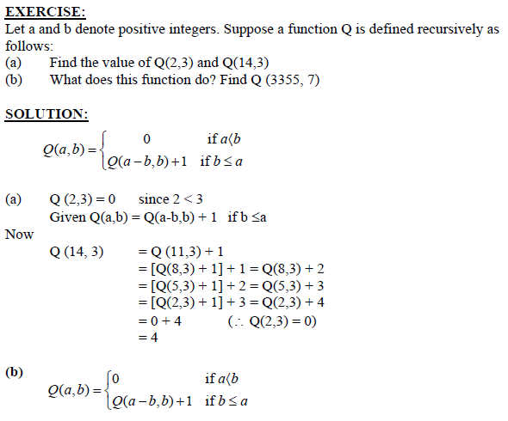

Slide 16
RECURRENCE RELATION:
A recurrence relation for a sequence a0, a1, a2, . . . , is a formula that relates each term ak
to certain of its predecessors ak-1, ak-2, . . . , ak-i ,
where i is a fixed integer and k is any integer greater than or equal to i. The initial
conditions for such a recurrence relation specify the values of
a0, a1, a2, . . . , ai-1.
EXERCISE:
Find the first four terms of the following recursively defined sequence.
b1 = 2
bk = bk-1 + 2 · k, for all integers k ≥ 2
SOLUTION:
b1 = 2 (given in base step)
b2 = b1 + 2 · 2 = 2 + 4 = 6
b3 = b2 + 2 · 3 = 6 + 6 = 12
b4 = b3 + 2 · 4 = 12 + 8 = 20

Slide 17
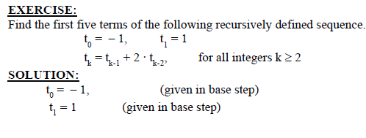


Slide 18
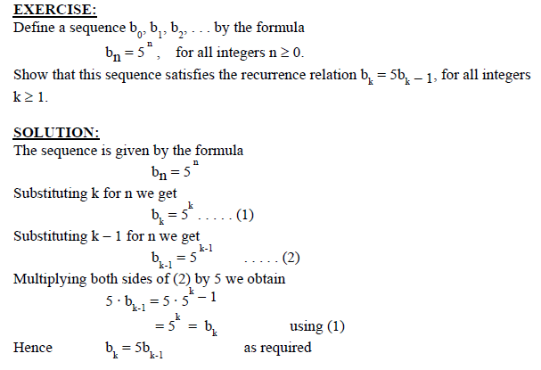

Slide 19
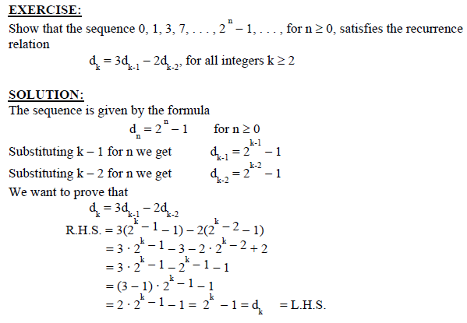

Slide 20
Recursion II
Recursion
A recursive definition (i.e to build the new set elements from the previous one,s)
for a set consists of the following three rules:
I. BASE: A statement that certain objects belong to the set.
II. RECURSION: A collection of rules indicating how to form new
set objects from those already known to be in the set.
III. RESTRICTION: A statement that no objects belong to the set
other than those coming from I and II.

Slide 21
EXERCISE:
Let S be a set defined recursively by
I. BASE: 5 ∈ S.
II. RECURSION: If x ∈ S and y ∈ S, then x + y ∈ S.
III. RESTRICTION: S contains no elements other than those obtained from rules I and II.
Show that S is the subset of all positive integers divisible by 5.
SOLUTION:
Let A be the set of all positive integers divisible by 5. Then
A = {5n | n ∈ N}.
We need to prove that S ⊆ A. 5 is divisible by 5 since 5 = 5 ⋅ 1, ⇒ 5 ∈ A
Now consider x ∈ A and y ∈ A, we show that x + y ∈ A
x ∈A⇒ 5 | x so that x = 5 ⋅ p for some p ∈N
y ∈A⇒ 5 | y so that y = 5 ⋅ q for some q ∈N
Hence x + y = 5 ⋅ p + 5 ⋅ q = 5 ⋅ (p + q)
⇒ 5 | (x + y) and so (x + y) ∈ A
Thus, S is a subset of A.

Slide 22
RECURSIVE DEFINITION OF THE SET OF STRINGS OVER AN ALPHABET
Consider a finite alphabet Σ = {a, b}. The set of all finite strings over Σ,
denoted Σ*, is defined recursively as follows:
I. BASE: ε is in Σ*, where ε is the null string.
II. RECURSION: If s ∈ Σ*, then
(a) sa ∈ Σ* and
(b) sb ∈ Σ*, where sa and sb are concatenations of s with a and b respectively.
III. RESTRICTION: Nothing is in Σ* other than objects defined in I and II
above.
EXERCISE:
Give derivations showing that abb is in Σ*.
SOLUTION
(1) ε ∈ Σ* by I.
(2) a = εa ∈ Σ* by (1) and II(a).
(3) ab ∈ Σ* by (2) and II(b).
(4) abb ∈ Σ* by (3) and II(b).
(3) ab ∈ Σ* by (2) and II(b).
(4) abb ∈ Σ* by (3) and II(b).

